Slide 1

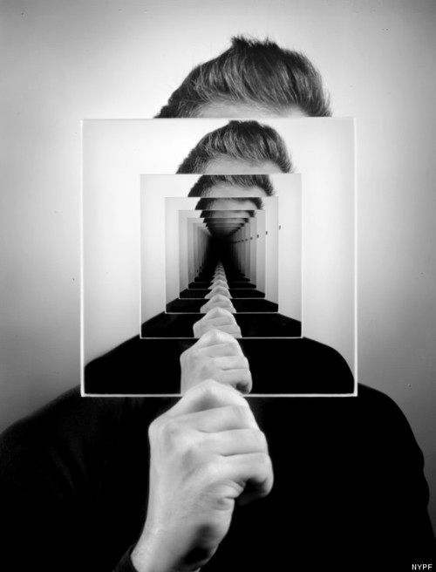
Concept: Connection
In this unit you will explore how artists use lenses to shift meaning. You will experiment, analyse artists, and develop your own visual viewpoint.
Inquiry Question:
How can artistic lenses change the meaning of people, places and objects to show my viewpoint about connection?

Slide 2

Experimental Investigation – Inquiry Phase 1
(Formative Assessment 1) 20% Due Term 1
You will:
complete four guided experiments (place, object, people, time)
analyse mentor artists and their influences
explore lenses, contexts and reverse chronology
document how your ideas develop
Submission: Digital presentation (up to 12 slides)
Focus: Exploration, experimentation, and understanding how lenses change meaning.
Project (focused personal inquiry) – Inquiry Phase 2
(Formative Assessment 2) 25% Due Term 2
You will:
choose one direction from your FIA1 experiments
refine your inquiry question
select your own mentor artist
develop a resolved body of work
Submission: Body of work + documentation
Focus: Deepening ideas, personal viewpoint, and purposeful development.

Slide 3

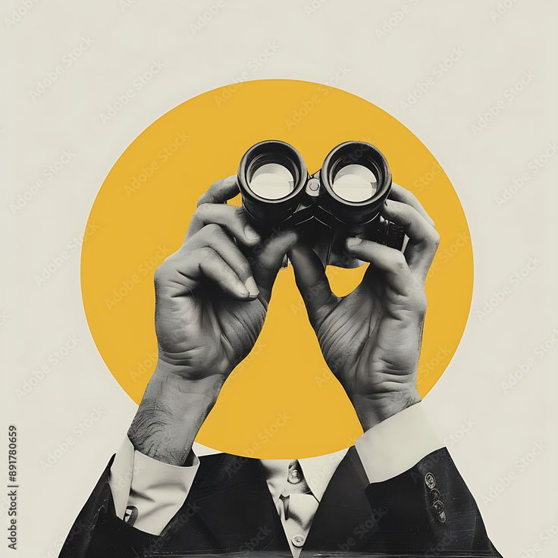




In this unit, art is not just about what things look like.
Art becomes a lens, meaning a way of interpreting the world.
Change perspective
highlight certain ideas
challenge assumptions
communicate viewpoints
A lens is a way of seeing, not a style.

Slide 4


Artists and audiences understand artworks through different contexts:
Personal Context The artist’s identity, experiences, memories, relationships, and environment.
Cultural Context Beliefs, traditions, and values connected to communities and societies.
Contemporary Context Issues, ideas, materials, and concerns relevant to today’s world.
Formal Context Visual language such as elements, principles, composition, materials, and techniques.
IN THIS UNIT
Your work will be shaped by two key contexts:
Personal Context
Your memories, identity, experiences, relationships, and environment.
Contemporary Context
How artists respond to issues, ideas, materials, and concerns in today’s world.
These contexts influence both:
the artists you study
the artworks you make

Slide 5

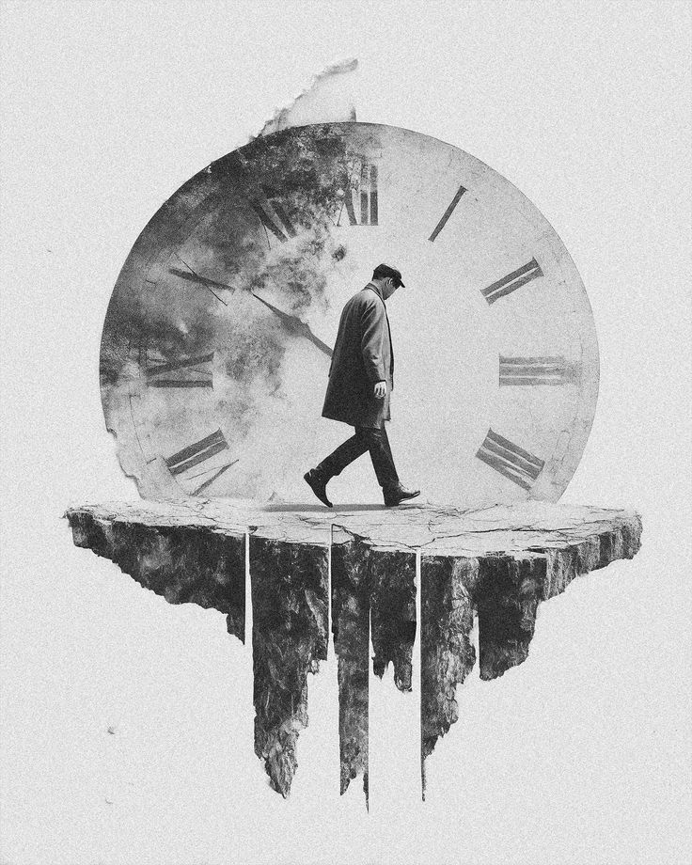

Artists do not create in isolation. Ideas travel through time.
You will explore reverse chronology, which means:
Contemporary Artist Historical Influence Your Work
This helps you understand:
how ideas evolve
how artists build on earlier practices
how your work sits within a lineage of thinking

Slide 6


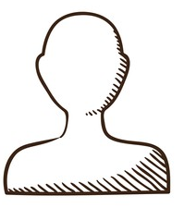
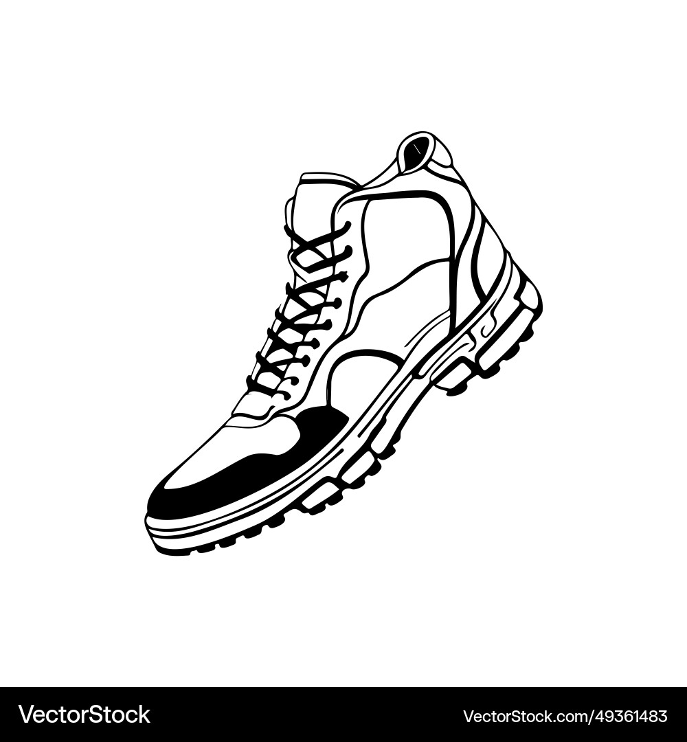

You will experiment with different lenses:
Experiment: People
Focus: Identity and inner experience Lens: Psychological
Experiment: Place
Focus: Environment and memory
Lens: Literal versus non-literal
Experiment: Object
Focus: Everyday material world
Lens: Objective versus subjective
Experiment: Time
Focus: Change and identity over time Lens: Psychological over time

Slide 7
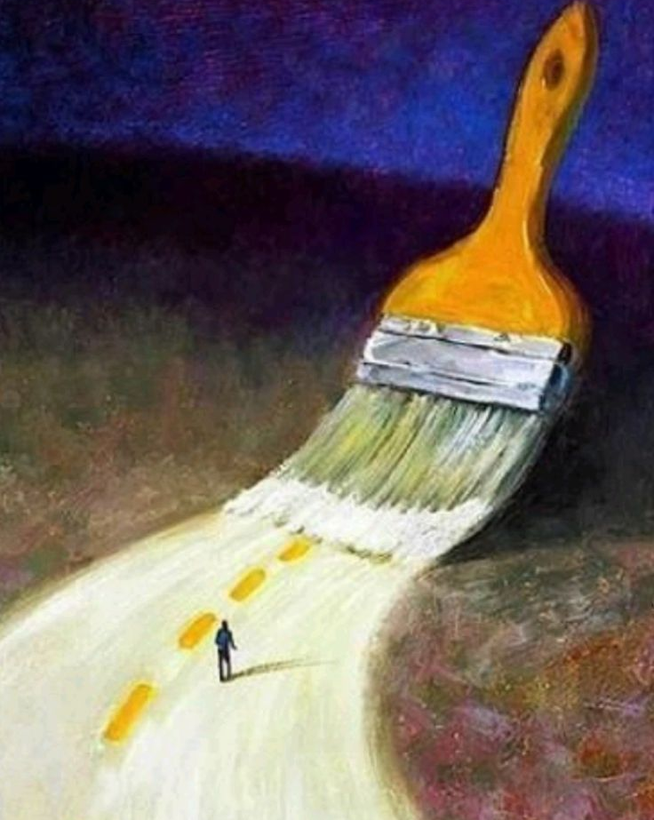




This unit follows a practice-based inquiry model.
You learn by:
Making
researching artists
Experimenting
reflecting
You will produce:
4 experimental artworks
a digital presentation (12 slides maximum)
Your slides will show:
your inquiry question
mentor artists
historical influences
your experiments
how your viewpoint developed

Slide 8

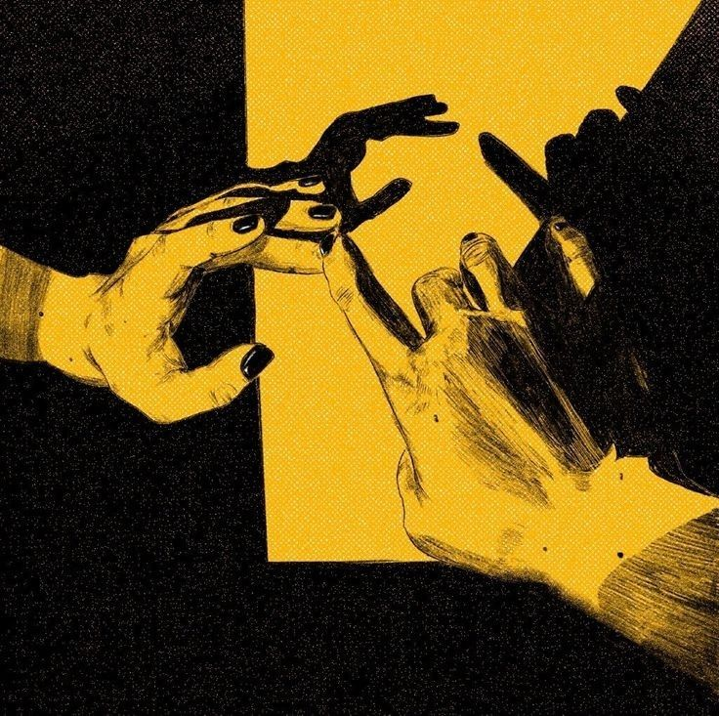

Connection can be:
EMOTIONAL
CULTURAL
ENVIRONMENTAL
PSYCHOLOGICAL
RELATIONAL
Each experiment asks:

Slide 9

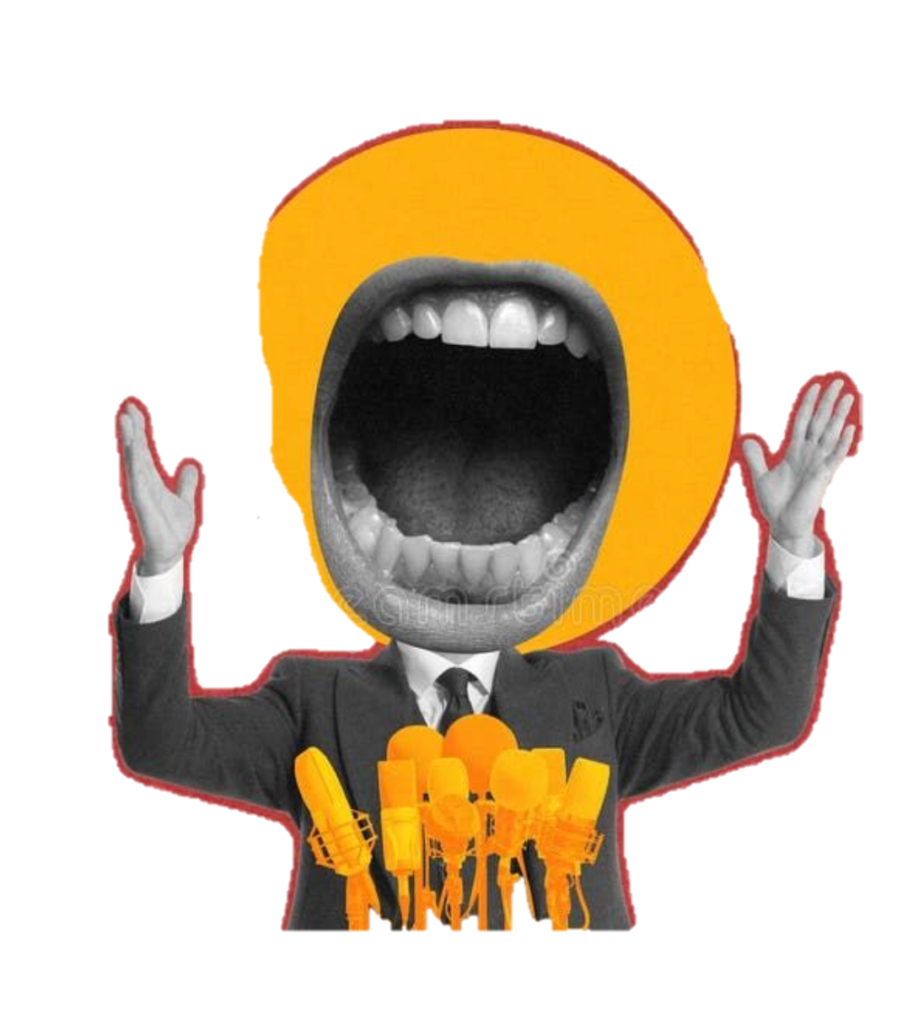
interpret your world through lenses
communicate personal viewpoints
consider how artists influence perspective
question how meaning is constructed

